Slide 1


Major Project Presentation On: “Cardiac Arrest Analysis and Detection”
KALPATARU INSTITUTE OF TECHNOLOGY
Department of Information Science & Engineering
2024-25
Project Associates:
Meghana B 1KI21IS032
Sharanya M E 1KI21IS050
Head of the Department :
Dr.Rajashekar K J
KIT,Tiptur
Under the Guidence of
Prof.Hanumantappa S
Assosiate professor
KIT,Tiptur

Slide 2
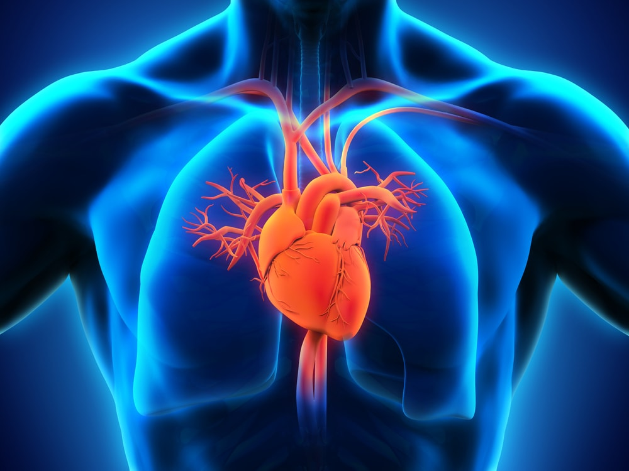
Introduction
Early detection of this condition is critical to provide the best care and ensure their long-term health.
In order to ensure the early detection of cardiac arrest in healthy persons, it is essential to understand the signs and symptoms associated with this condition.
The risk factors that may put health at an increased risk of cardiac arrest is essential to understand.
Prevalence of Cardiac Issues and the Need for Accurate Prediction:
According to the World Health Organization (WHO), an estimated 17.9 million deaths occur each year due to CVDs, representing 31% of global deaths.
Cardiac issues often occurs with no symptoms until they reach an advanced stage, so making early detection challenging.

Slide 3
Problem Statement
This study gives efficient approach to classify ECG signals with high accuracy. Each heartbeat is a combination of action impulse waveforms produced by different specialized cardiac heart tissues. Heartbeats classification faces some difficulties because these waveforms differ from person to another, they are described by some features. These features are the inputs of deep learning algorithm.

Slide 4
Objectives
Multiples classifiers are proposed for ECG classification, these classifiers are used mostly in Big Data and Machine Learning fields by the weighted voting principle.
Each classifier influences the final decision according to its performance on the training data.
Parameters of each classifier are adjusted on the basis of an individual classifier’s performance on the training data by applying the pseudo inverse technique.

Slide 5
Challenges in Cardiac Health:
Late Detection of Cardiovascular Issues:
Problem: Many cardiac conditions remain asymptomatic until reaching an advanced stage, hindering early detection.
Impact: Late detection often leads to severe complications and limited treatment options.
Limited Personalization in Treatment Plans:
Problem: Traditional approaches may not consider individual variations in genetics, lifestyle, and other factors when creating treatment plans.
Impact: One-size-fits-all treatments may not be as effective, leading to suboptimal outcomes for some individuals.
Data Overload and Interpretation:
Problem: The abundance of health data poses a challenge in extracting meaningful patterns and insights.
Impact: Without effective interpretation, valuable information may be overlooked or misinterpreted.

Slide 6
Overview Machine Learning and Deep Learning
Machine learning (ML) and deep learning (DL) techniques offer innovative solutions to address the challenges of cardiac health prediction. These approaches leverage computational algorithms and data-driven models to:
Risk Stratification: Identify individuals at high risk of developing cardiac issues based on various risk factors, lifestyle choices, and genetic predispositions.
Personalized Medicine: Tailor interventions and treatment plans based on an individual's unique health profile, optimizing outcomes and reducing adverse events.
Early Detection: Detect subtle patterns in data that may indicate the onset of cardiac abnormalities before traditional diagnostic methods can identify them.
Decision Support: Assist healthcare professionals in making informed decisions by providing predictive insights and risk assessments.

Slide 7
Literature Survey
PAPER | DATASETS | OBJECTIVES | METHODOLOGY | PERFORMANCE
IEEE 2017 | For this study, they implemented an embedded sensory system with a Low Energy (LE) Bluetooth communication module to collect ECG and body temperature data using a smartphone in a common environment. https://ieeexplore.ieee.org/document/8030013 | Sudden cardiac death is predicted 1 hr before its occurrence. | Machine Learning and Deep Learning algorithms like Random Forest,Decision Tree. | 73%
Science Direct 2023 | Kaggle Framingham heart dataset has larger sample size(4328) compared to other datasets. https://www.sciencedirect.com/science/article/pii/S2665917423001289 | They use Deep Learning and Auto-encoders(DAE) for automated detection of cardiac arrest in human beings. | ANN,BPNN,SVM | 80%

Slide 8
Literature Survey
PAPER | DATASETS | OBJECTIVES | METHODOLOGY | PERFORMANCE
IEEE 2019 | EHRs of adult patients. https://ieeexplore.ieee.org/document/8959922 | Detect CA before CPR event occurred earlier , Assists physicians to early diagnose of CA and also improving the medical quality. | Deep Learning algorithms like Random Forest algorithm. | 124-CA +ve patients. 43,445-CA –ve patients. 81%
MDPI 2022 | The number of past patient data of 64h,PPV and sensitivity were highest. https://www.mdpi.com/2227-7390/10/12/2049 | They performed a correlation analysis between occurrence of cardiac arrest and biosignal data and laboratory data. | Machine Learning and Deep Learning like Random Forest,Decision Tree. | 85%

Slide 9
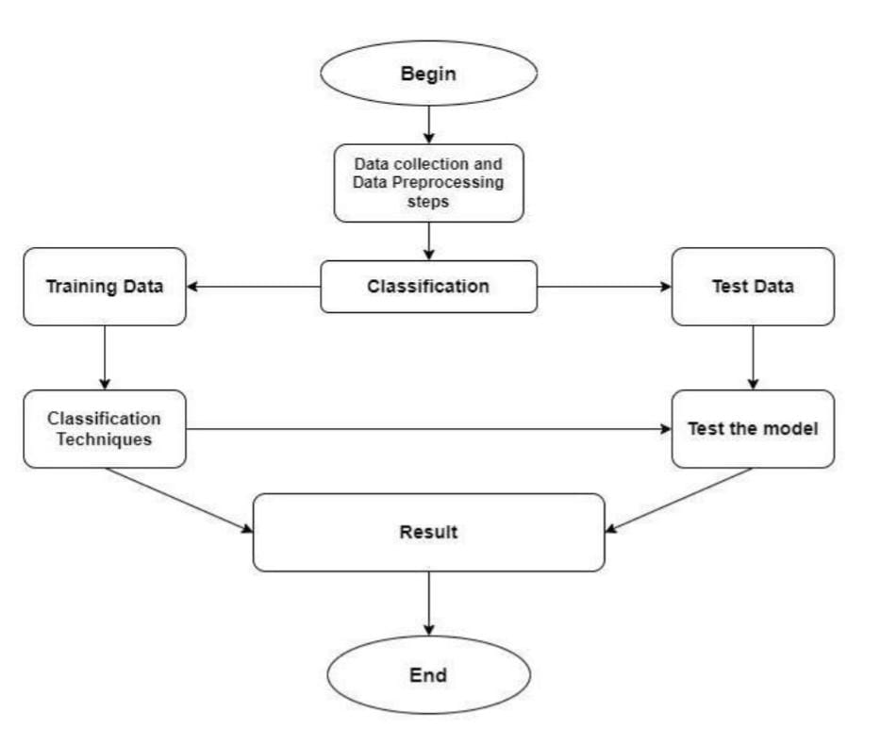
System Architecture:

Slide 10
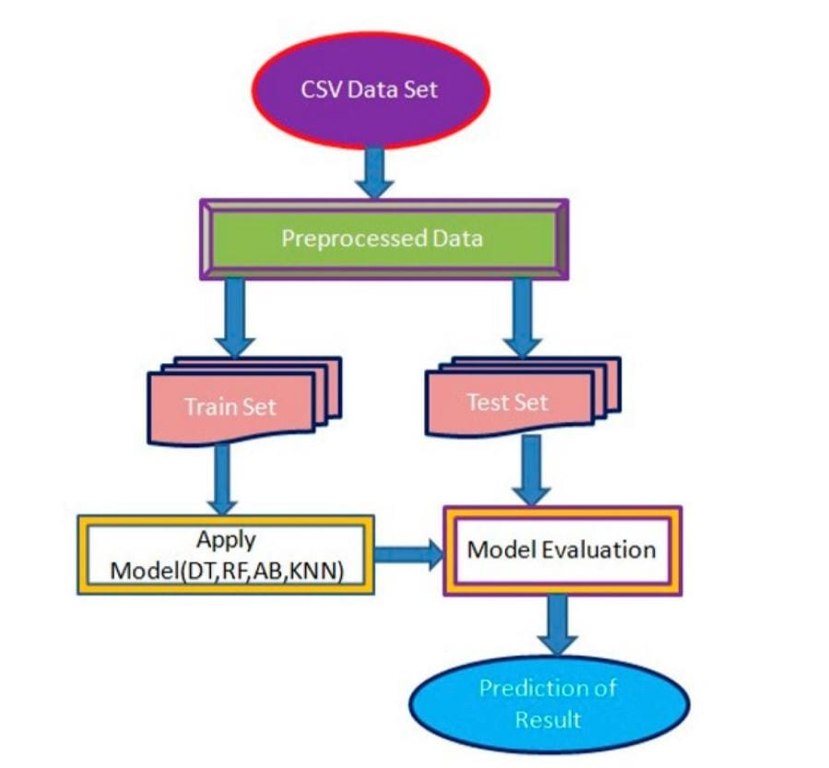
Data flow diagram

Slide 11
Proposed Methodology
Step 1
Step 2
Step 3
Problem Formulation
Data Collection
Data Analysis
(Processing, Feature Extraction)
Step 6
Step 5
Step 4
Deployment & Inference
(speed, stability & accuracy of inference)
Model Validation
(Validation & Error Analysis)
Model Construction
(Training & Tuning)

Slide 12
Technologies used are :
Machine Learning Algorithms:
The project focuses on heart disease detection using machine learning algorithms. Below are the Algorithms used in the project and their relevance:
Supervised Learning AlgorithmsThese algorithms are used for classification, where the model predicts whether a person has heart disease or not.
Logistic Regression:Used for binary classification (Heart Disease: Yes/No).Helps in identifying risk factors by calculating probabilities.
Decision Tree Classifier:A tree-like model that makes predictions based on features like blood pressure and cholesterol.Simple and easy to interpret for medical analysis.
Random Forest Classifier:An ensemble of decision trees that improves accuracy and reduces overfitting.Helps in detecting complex patterns in ECG signals.
K-Nearest Neighbors (KNN):Classifies heartbeats based on similarity with past cases.
Support Vector Regression (SVR):Predicts continuous values like heart rate variability.

Slide 13
Big Data Technologies:
Apache Spark (Scala) for processing large-scale ECG datasets
Programming & Data Processing:
Python (for machine learning models)
NumPy, Pandas (for data handling)
Seaborn Matplotlib (for visualization)
Scikit-learn (for machine learning implementation)
TensorFlow, Keras (for deep learning models)
Data Collection & Preprocessing:
Electrocardiogram (ECG) signal processing
Data cleaning and feature extraction using Python
Outlier removal and normalization techniques (IQR, Standard Scaler)

Slide 14
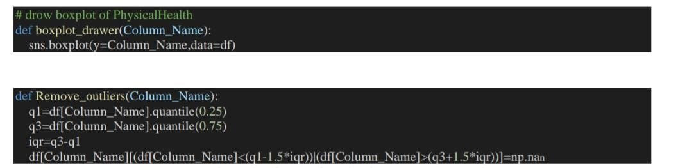
Implementation
The above is the code to fetch the data sets required for analysis .
It implements to draw a boxplot of physical health column and remove outliers from it .
It utilizes seaborn to visualize the distribution

Slide 15
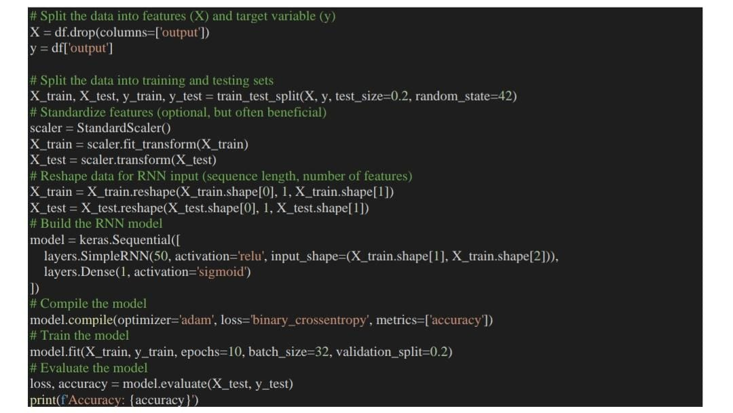
Code for data pre-processing

Slide 16
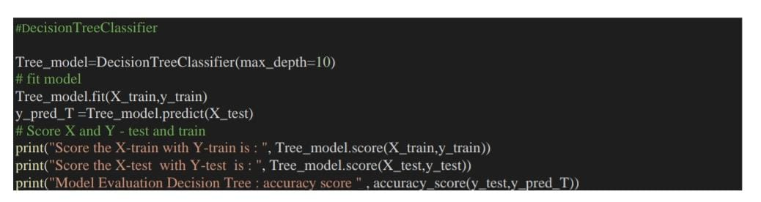
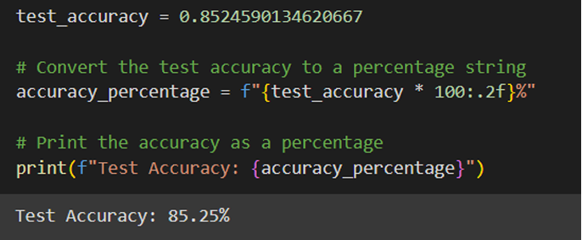

Slide 17
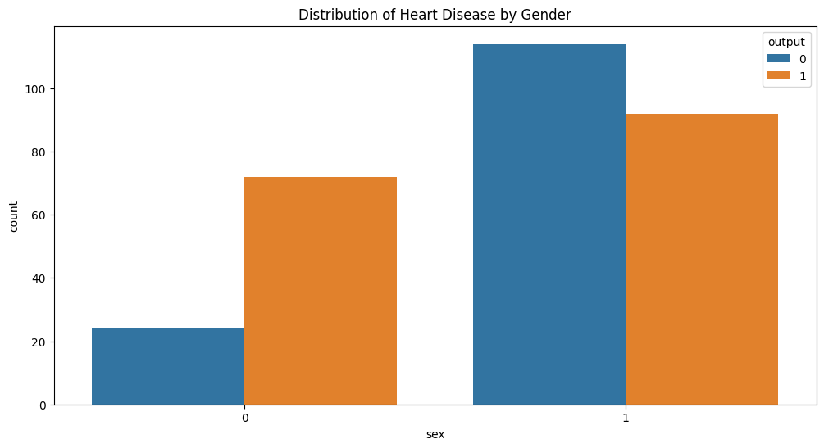
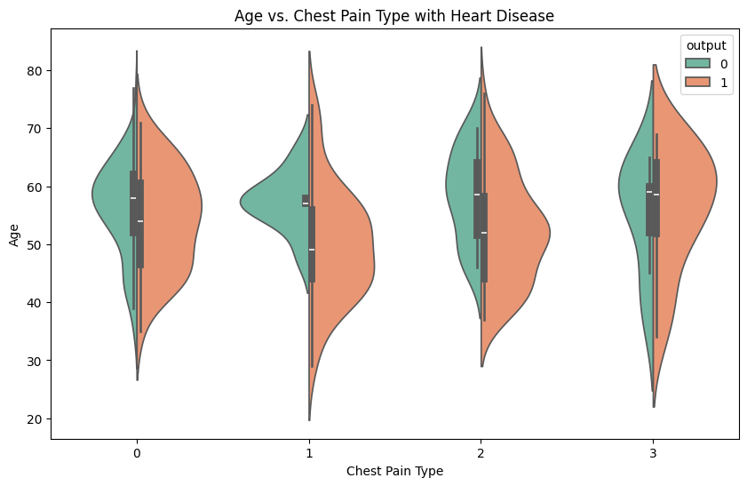
Data analysis results:

Slide 18
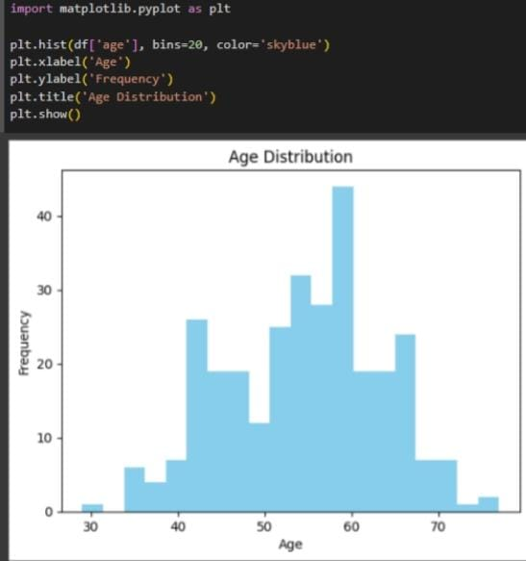
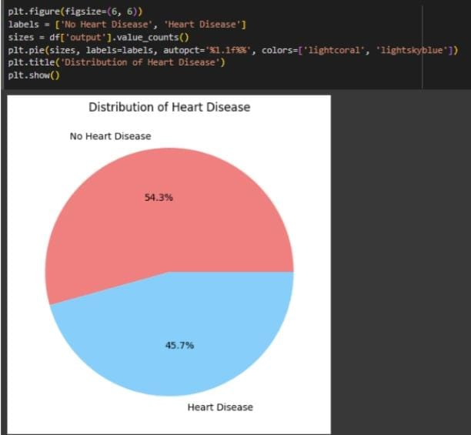
Age distribution of people with heart disease
Distribution of heart disease

Slide 19
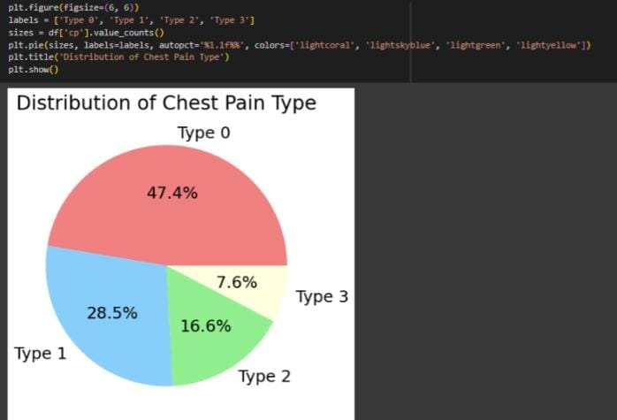
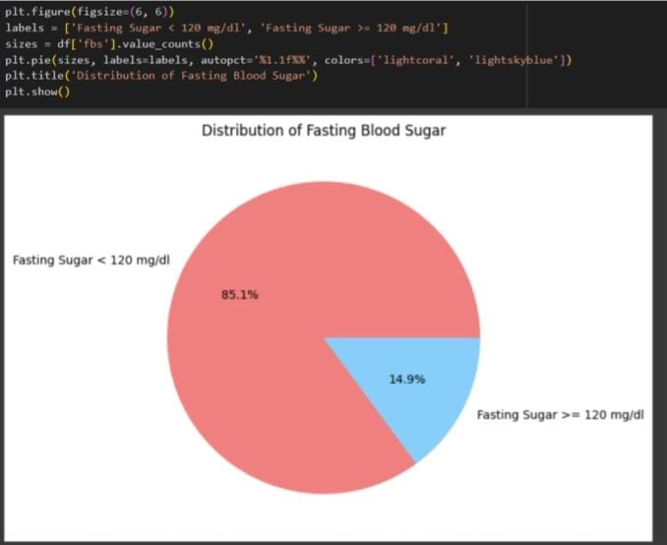
Distribution of chest pain type
Distribution of fasting blood sugar

Slide 20
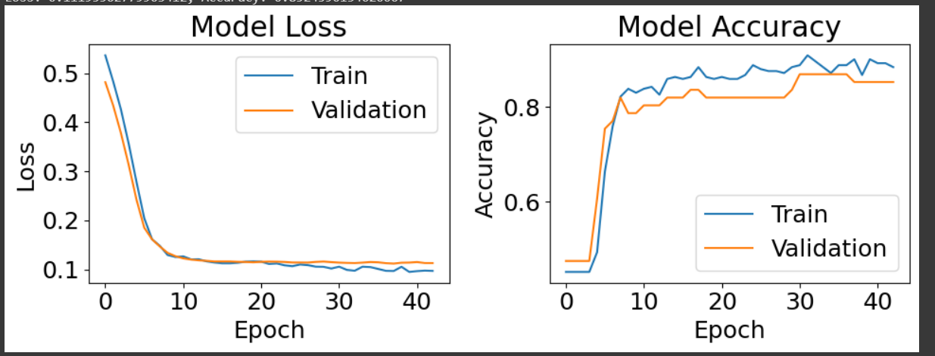
Result
Sl.No | Algorithms | Accuracy
1 | Logistic Regression | 83.60%
2 | Decision Tree Classifier | 77.04%
3 | SVR | 60.52%
4 | SVC | 60.52%
5 | GridSearch | 88.65%
6 | Random Forest | 88.15%
7 | K -Neighbours | 71.05%
8 | RNN | 85.25%
Graph of model loss and model accuracy
Model Performance

Slide 21
Conclusion
In conclusion, the utilization of deep learning approaches for the early detection of cardiac arrest presents a promising avenue for improving patient outcomes and reducing the burden of cardiovascular diseases. The proposed system harnesses the power of advanced neural network architectures, multi-model data integration, and real-time monitoring capabilities to enable timely detection, personalized risk assessment, and proactive intervention.

Slide 22
Future Enhancement
As illustrated before the system can be used as a clinical assistant for any clinicians. The disease prediction through the risk factors can be hosted online and hence any internet users can access the system through a web browser and understand the risk of heart disease. The proposed model can be implemented for any real time application .

Slide 23
THANK YOU
Presented by-
Meghana B
Sharanya M E

